Slide 1


Battle-Hardened AI
Full details in: https://github.com/yuhisern7/battle-hardened-ai

Slide 2
The Details Here Are Proven
This document is written for people who understand first-layer enforcement, gateways, and control planes. It assumes familiarity with firewalls, routing, kernel telemetry, and pre-execution decision systems.
Nothing in Battle-Hardened AI is designed as a marketing gimmick: every term (21 layers, semantic execution-denial, trust graph, causal inference) corresponds to concrete modules, code paths, and enforcement points that can be inspected in this repository and its documentation.

Slide 3
Autonomous Execution-Control System
A new category of security engineered to operate at the first layer - router and gateway boundary, where it functions as an upstream execution-control authority rather than a downstream detection engine. Positioned at the network ingress and egress edge, it evaluates interactions before they acquire operational meaning, issuing deterministic allow or deny decisions prior to engagement with firewalls, NGFWs, IDS/IPS, or endpoint tools.
Instead of relying solely on signatures or reactive alerts, it performs pre-execution decisioning with full contextual awareness—correlating semantic intent, behavioral patterns, temporal sequencing, environmental state, and causal relationships across observed entities. This enables it to assess not only what is occurring, but why it is occurring and whether the interaction is logically valid within the system’s defined execution model.
By acting at this first control layer, it reduces attack surface exposure, suppresses malicious state transitions before propagation, and supplies structured decision outputs that downstream security systems can enforce, correlate, and audit. The result is a unified decision plane that precedes and strengthens the existing security stack rather than competing with it.

Slide 4
Summary Highlights
Blocks malicious actions **before execution** using a 21-layer AI ensemble and a final semantic execution-denial gate.
Acts as a **first-layer firewall commander** for gateways and routers, deciding what should be blocked while delegating actual enforcement to the local firewall control plane.
Works **without agents**, exporting neutral JSON that plugs into existing SIEM, SOAR, firewall, and XDR stacks.
Provides documented coverage for **43 MITRE ATT&CK techniques** via pre-execution denial and trust degradation.
Built for **enterprise, government, and national-security** defense use cases where autonomy, auditability, and privacy are mandatory.
Optionally connects to a **central relay/VPS** where many Battle-Hardened AI nodes share only sanitized attack patterns and receive model/signature updates,
So global learning improves over time without any customer content or PII leaving local infrastructure.
Implements **5 production-ready ML pipeline hardening features** (see *Architecture Enhancements: ML Pipeline Hardening Layer* below for details).

Slide 5
Executive Summary
**Stop breaches before they start:** Battle-Hardened AI sits at the gateway and decides what is allowed to execute, blocking malicious activity before it reaches servers, endpoints, or data.
**Reduce analyst load, not add to it:** It runs autonomously with explainable decisions and conservative defaults, cutting noise instead of generating more alerts.
**Integrate with what you already have:** Decisions are exported as simple JSON and enforced through existing firewalls, SIEM, SOAR, and EDR/XDR tools—no rip-and-replace.
**Protect privacy and sovereignty:** Detection happens on your infrastructure, and when the optional relay to the central VPS is enabled, only anonymized
Patterns and statistics are shared—no raw payloads, credentials, or customer data.

Slide 6
What Battle-Hardened AI Is Not
To remain strictly focused as a first-layer decision system, Battle-Hardened AI does not:
Act as a SIEM (log aggregator)
Act as a SOAR (workflow orchestrator)
Act as an EDR (host process monitor)
Act as an IAM (identity manager)
Act as a threat intel aggregator
It makes execution decisions only.

Slide 7
THE TOPOLOGIES

Slide 8
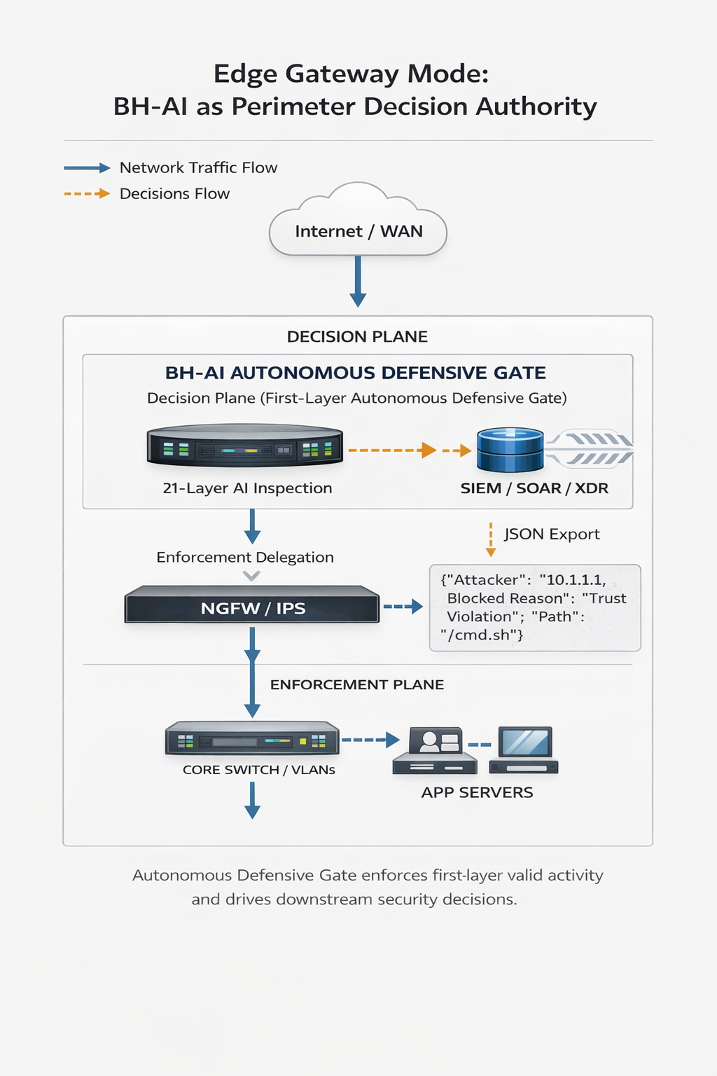
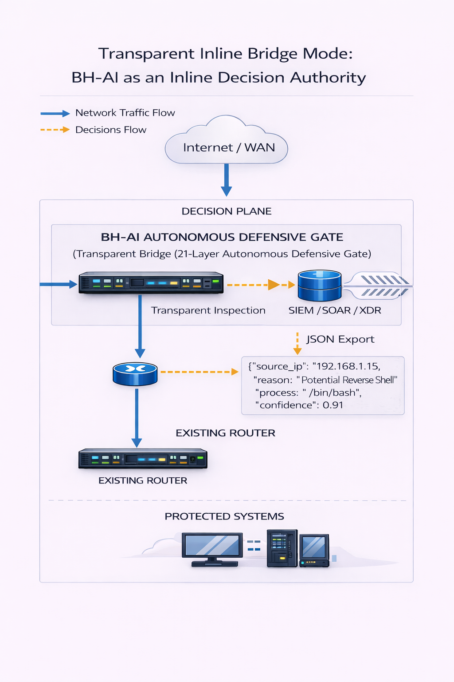

Slide 9
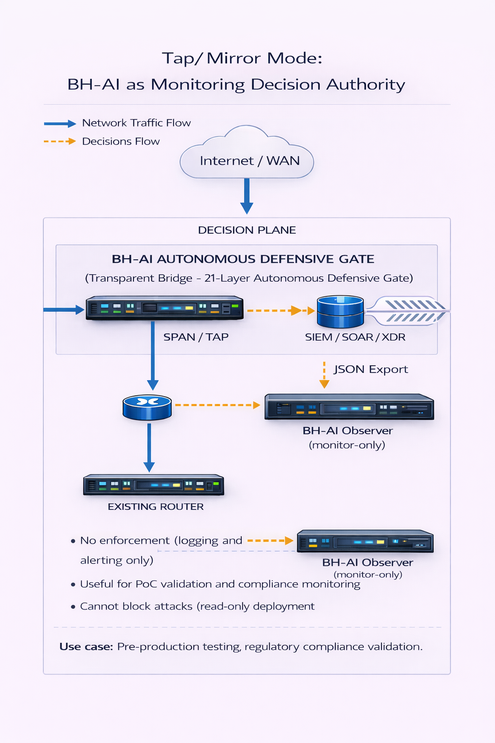
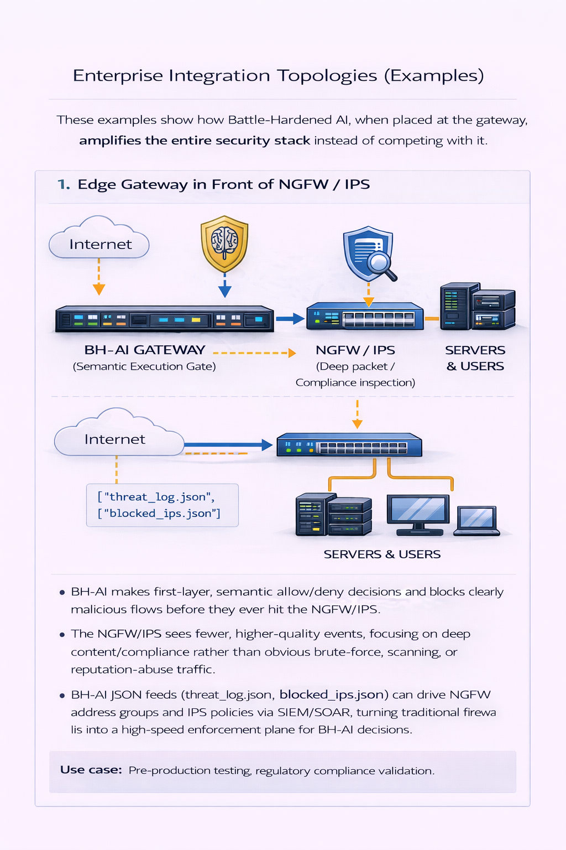

Slide 10
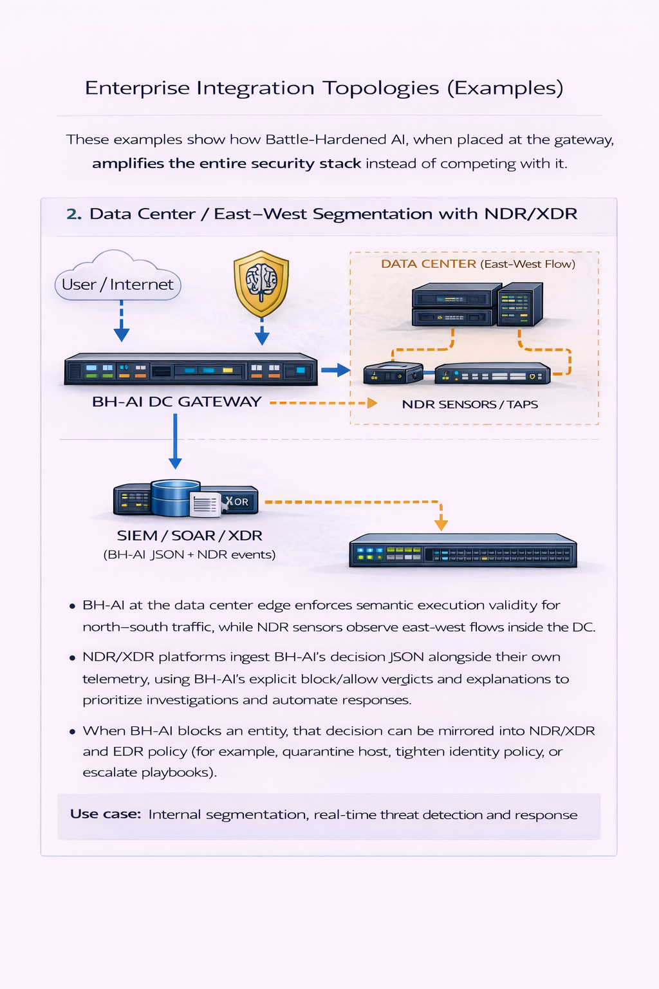
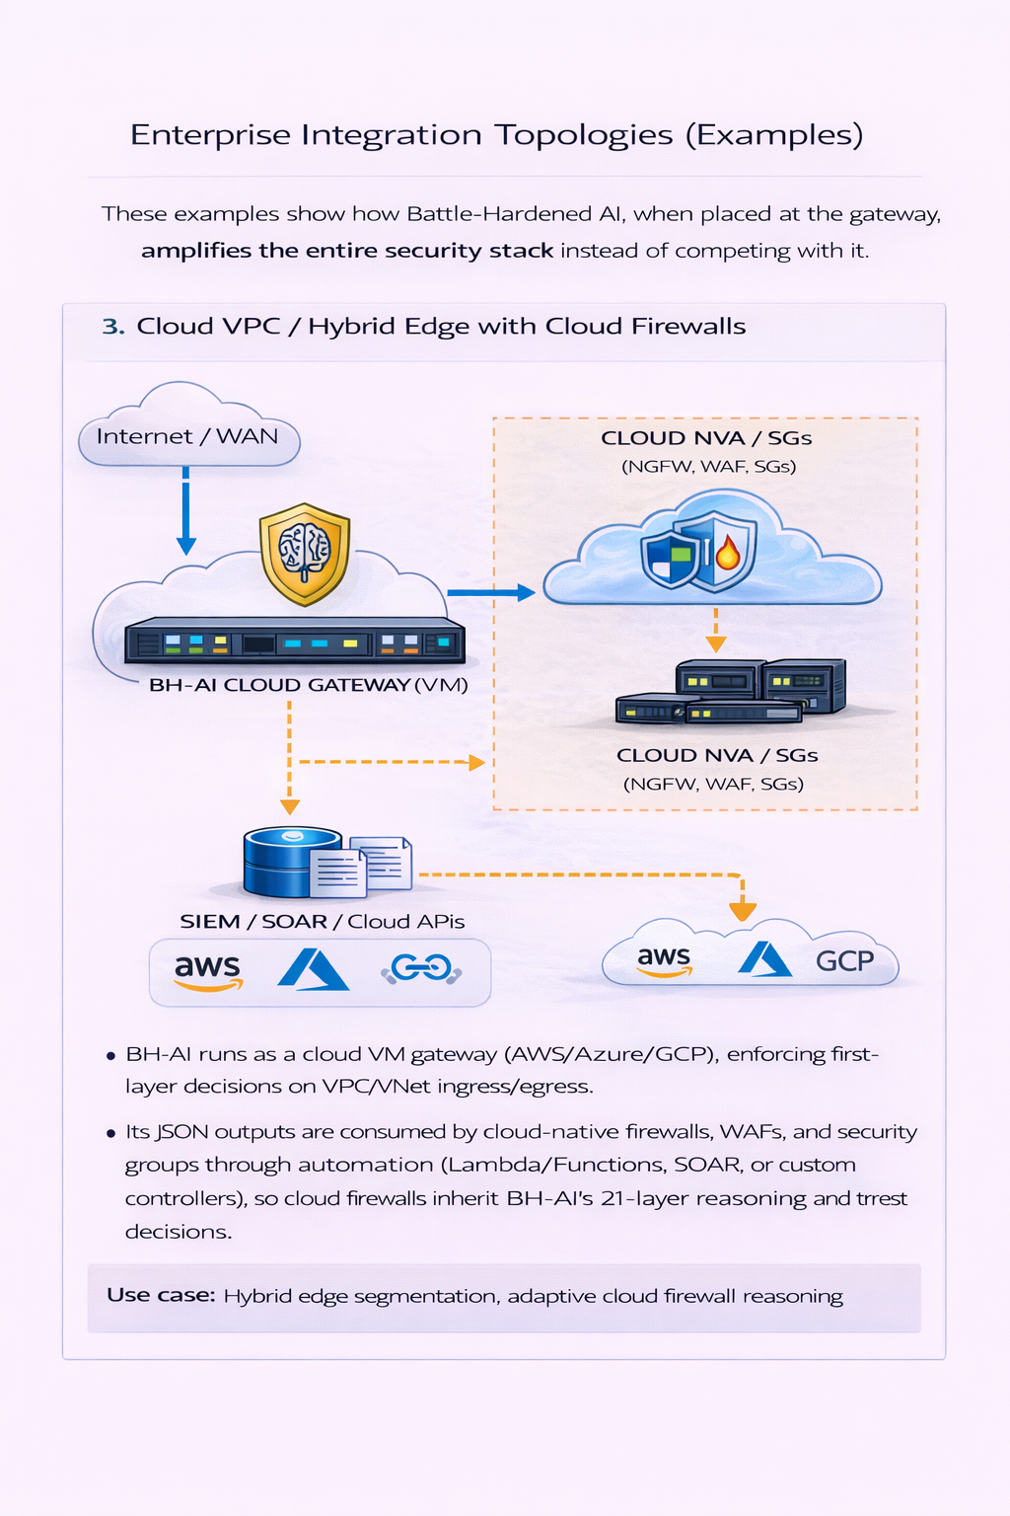

Slide 11
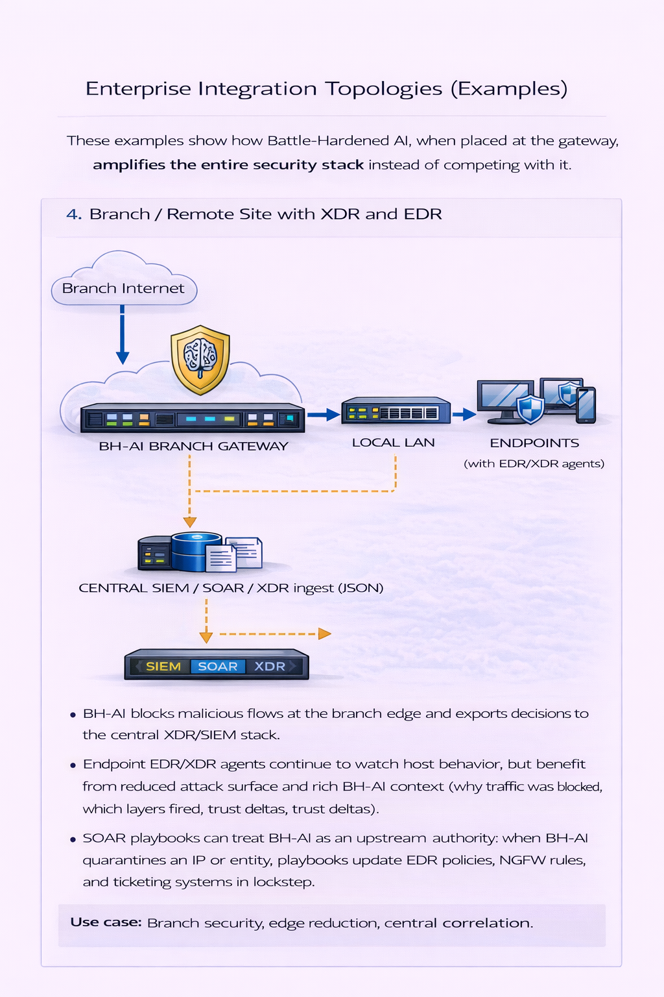
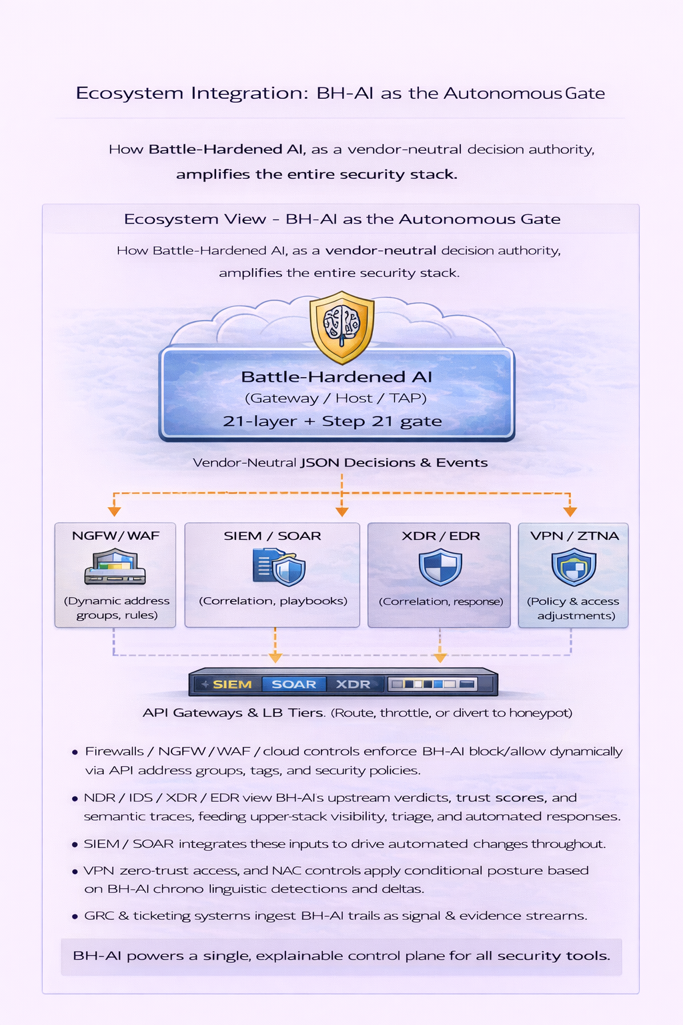

Slide 12
DEEP DIVE

Slide 13
What Makes Us Different
Battle-Hardened AI is not "better analytics on the same events"—it is a **first-layer semantic execution-control system** that decides if interactions are allowed to exist at all, then drives existing firewalls and security tools with those decisions. For detailed vendor and platform comparison, including timing and stack placement.
🧪 Example: SSH Credential Stuffing
**Traditional flow:** Attackers perform high-volume or distributed SSH login attempts. Sessions are established, and only then do downstream tools detect anomalies and raise alerts.
**With Battle-Hardened AI:** Behavioral, sequence, and trust signals flag abnormal SSH login patterns. Trust for the source degrades, and the semantic execution-denial gate determines that the login attempts are not legitimate for the entity.
**Outcome:** Connections are blocked **before** successful session establishment, and the attacker cannot meaningfully interact with protected systems.

Slide 14
Privacy-Preserving Defensive Mesh
**One server protects an entire network segment (no endpoint agents required)** – implemented by the **Gateway/Router** deployment role, where a single Linux node commands the OS firewall for all devices behind it
**Every attack makes the system smarter (automated signature extraction + ML retraining)** – Stage 5 extracts sanitized signatures, statistics, graph patterns, and reputation into local JSON, and Stage 7/relay retraining fold those into new models and signatures
**Every node benefits from global learning (relay-shared intelligence from worldwide attacks)** – when the optional relay is enabled, nodes push only sanitized patterns and pull signed models, signatures, and reputation feeds; no customer training data is shared
**Organizations retain full control (relay participation is optional, all data anonymized)** – relay connectivity is opt-in and can be disabled entirely at install or runtime; when enabled, uploads are restricted to anonymized patterns and aggregated statistics
**Privacy is preserved (no raw payloads, no PII, only statistical features shared)** – Stage 5 and the relay-side training pipeline are explicitly designed to avoid raw payloads, credentials, and PII; only statistical features, signatures, and anonymized topology are shared

Slide 15
Enhancing Existing Security Controls (part 1)
Battle-Hardened AI’s Linux and Windows deployments act as a **semantic decision engine in front of the existing stack**, not a replacement. Its JSON outputs (for example, `threat_log.json` and `blocked_ips.json`) and local OS firewall control are designed to amplify:
**Network firewalls and cloud controls** – NGFW, WAF, and cloud security groups/NVAs inherit BH-AI allow/block decisions via dynamic address objects, tags, or automation, so packet-level enforcement (including NAT and segmentation) reflects the 21-layer semantic verdicts.
**Detection and response platforms** – IDS/IPS, NDR, XDR, and EDR ingest BH-AI decisions as high-signal events, enriching detections, tightening containment policies, and aligning host- and network-level responses around a shared trust score.
**SIEM and SOAR tooling** – SIEMs correlate BH-AI events with logs from other sensors, while SOAR playbooks use its explainable verdicts to drive coordinated changes across NGFW/WAF, XDR/EDR, VPN, ZTNA, and NAC policies.

Slide 16
Enhancing Existing Security Controls (part 2)
**Access and edge controls** – VPN concentrators, ZTNA controllers, and NAC platforms can consume BH-AI trust outputs to adapt access (tighten posture checks, quarantine segments, or force re-authentication) when semantic risk increases.
**Application gateways and traffic managers** – API gateways, reverse proxies, and load balancers can route suspicious flows toward honeypots, throttling, or deeper inspection based on BH-AI’s verdicts, reducing exposure for critical backends.
**GRC, ITSM, and audit workflows** – Ticketing, GRC, and audit systems can treat BH-AI block decisions as structured, explainable evidence, linking individual enforcement actions (on Linux iptables/ipset/nftables or Windows Defender Firewall) to cases, approvals, and runbooks.
Integration with SIEM/SOAR happens via JSON export, not enforcement path

Slide 17
21 AI DETECTION SIGNALS

Slide 18
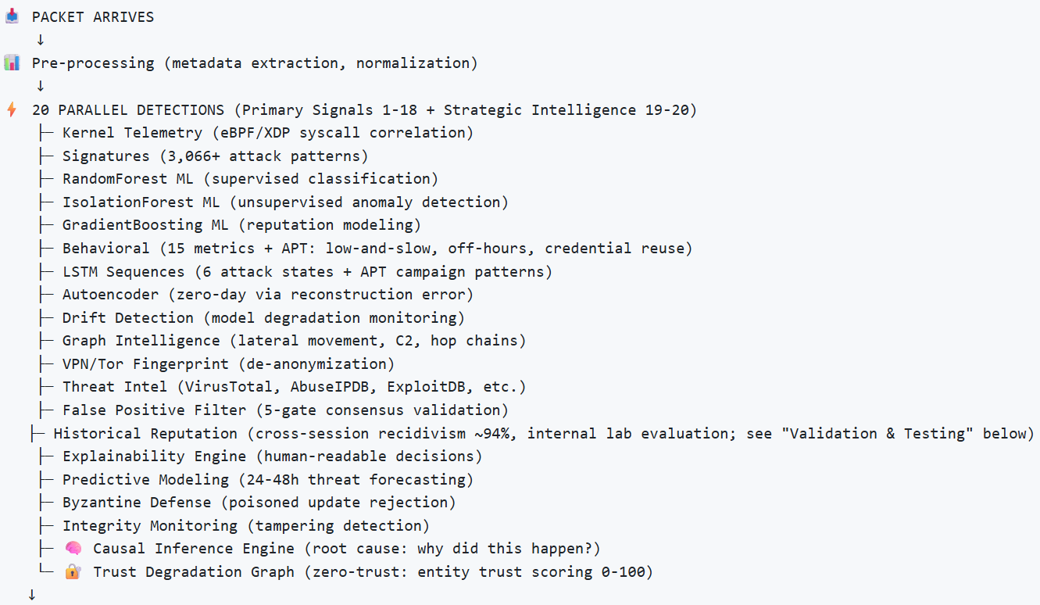
The Flow of BH-AI (part 1)

Slide 19
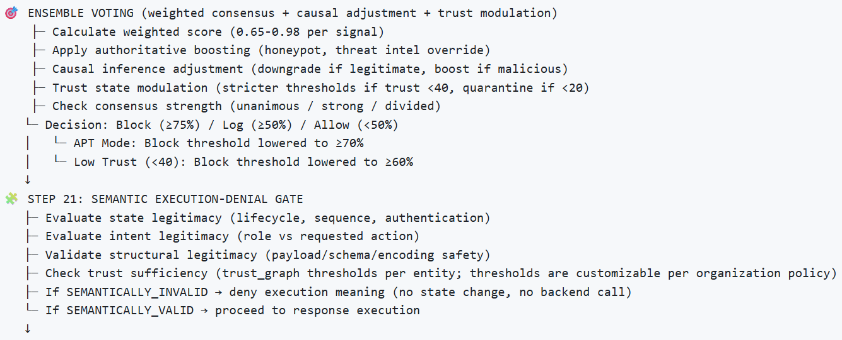
The Flow of BH-AI (part 2)

Slide 20
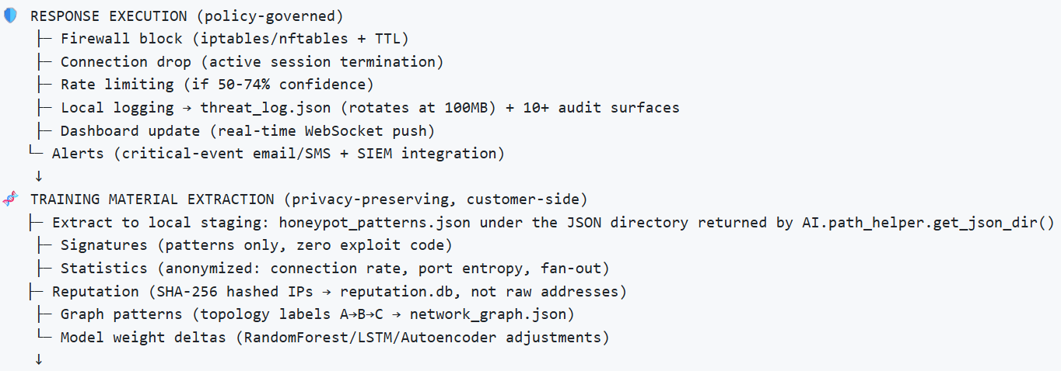
The Flow of BH-AI (part 3)

Slide 21
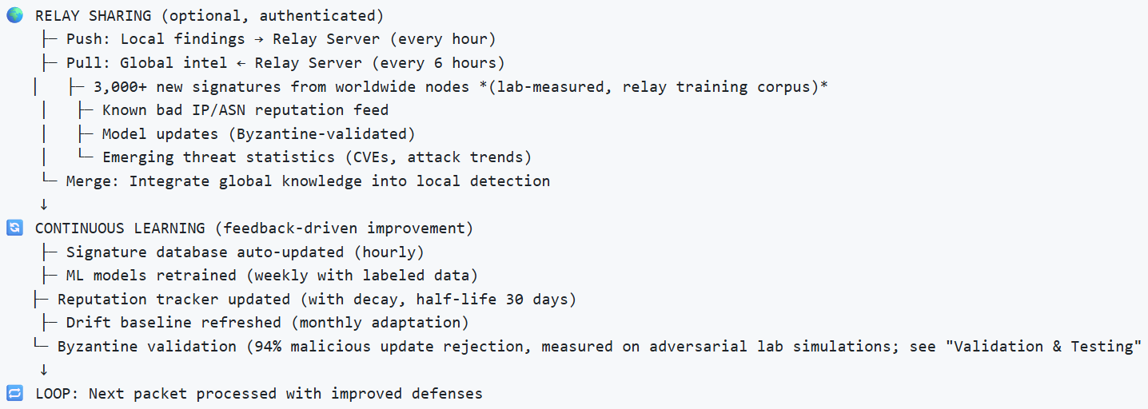
The Flow of BH-AI (part 4)

Slide 22
THANK YOU FOR YOUR TIME

